Slide 1
Developing JSPs and JSTL

Slide 2

JSP dynamic templating engine
Overview
Jasper: from JSPs to servlet source code
JSP Expressions JSP Scriplets JSP Declarations
JSP and Java beans
JSP and the Java Standard Tag Library

Slide 3
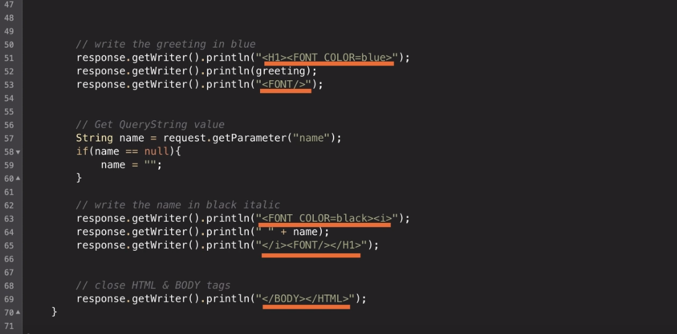

Slide 4


Evolution of JSPs
2019
Jakarta Server Pages
Eclipse Foundation
1999
JavaServer Pages Java Community Process
1998
JavaServer Pages
Sun Microsystems
2019

Slide 5
JSP Expressions

Slide 6
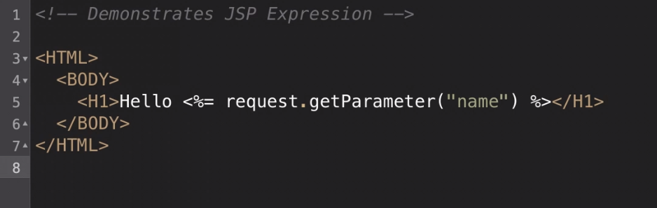

Slide 7
JSP Implicit Objects
Object Reference Name | Object Type
out | JspWriter
request | HttpServletRequest
response | HttpServletResponse
config | ServletConfig
application | ServletContext
session | HttpSession
pageContext | PageContext
page | Object
exception | Throwable

Slide 8

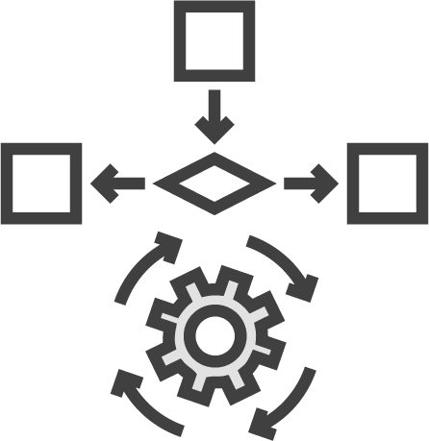











Tomcat Architecture
Web Clients
Tomcat
Resources
Coyote
Catalina
Jasper
Web-Apps
JSP

Slide 9



Tomcat Architecture
Web Clients
Tomcat
Resources
Web-Apps
Coyote
Catalina
Jasper

Slide 10
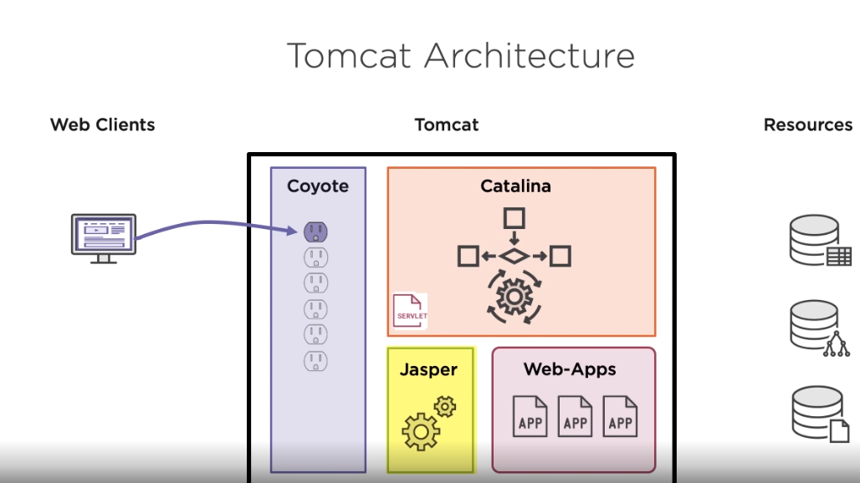

Slide 11
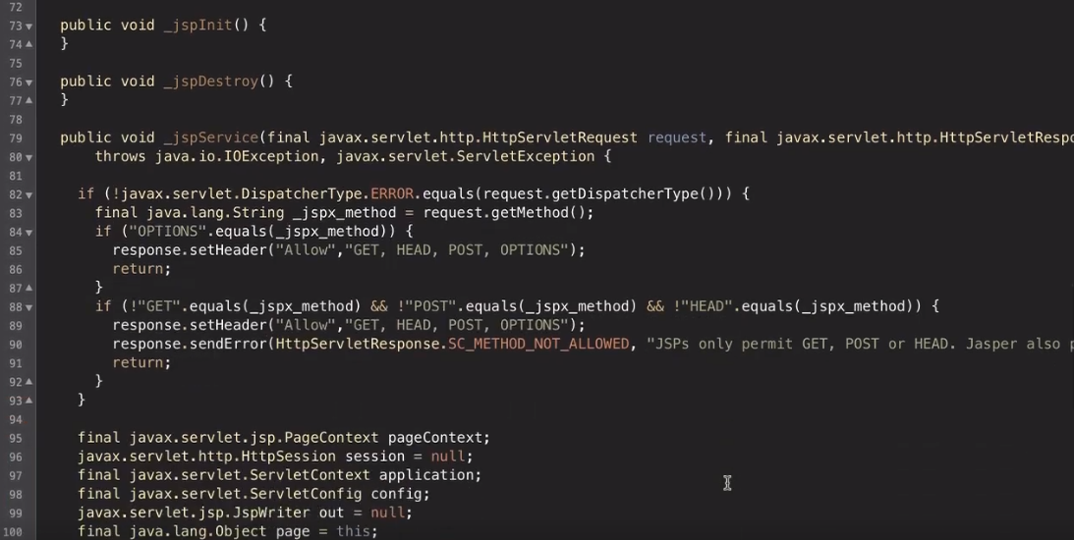

Slide 12
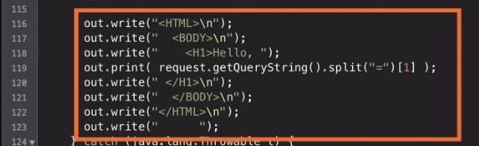

Slide 13
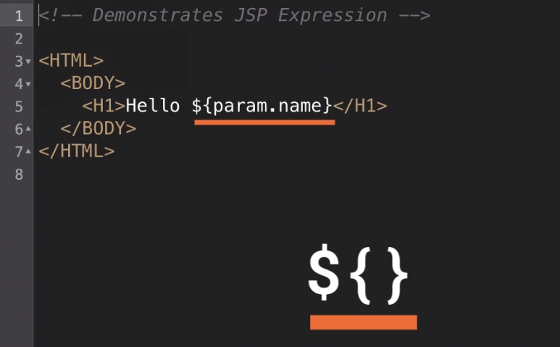

Slide 14
EL Implicit Map Objects
Map Reference Name | Map Reference Name
param | pageScope
paramValues | requestScope
header | sessionScope
headerValues | applicationScope
cookie
pageContext
pageContext
initParam
exception

Slide 15
HTTP Request
GET /example/ HTTP 1.1
Host: localhost:8080 User-Agent: Mozilla/5.0
Accept-Language : en,fr;q=0.9
Headers
100110 | 111010 | 001011 | 101001 | 111010
111010 | 100110 | 101001 | 111010 | 100110
101001 | 111010 | 100110 | 111010 | 100110
100110 | 111010 | 001011 | 101001 | 111010
111010 | 100110 | 101001 | 111010 | 100110
101001 | 111010 | 100110 | 111010 | 100110
100110 | 111010 | 001011 | 101001 | 111010
111010 | 100110 | 101001 | 111010 | 100110
Body

Slide 16
JSP Scriptlets

Slide 17
JSP Declarations

Slide 18
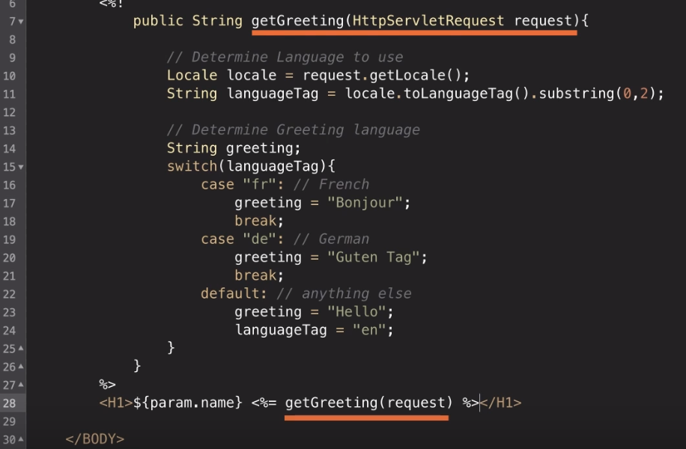

Slide 19
JSP and Java beans

Slide 20
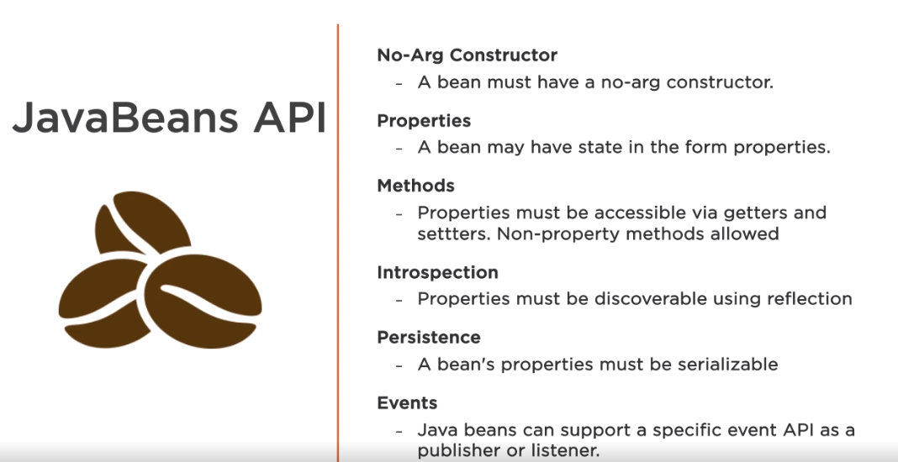

Slide 21
JSP Standard Tag Libraries

Slide 22
JSP Standard Tag Libraries
JSTL Core
Control and Flow
JSTL Formatting
Date/Number Formatting Internationalization
JSTL Functions
EL Utility Functions
JSTL XML
Parsing XML
JSTL SQL
Executing SQL

Slide 23
JSP Standard Tag Libraries
JSTL Core
Control and Flow
JSTL Formatting
Date/Number Formatting Internationalization
JSTL Functions
EL Utility Functions
JSTL XML
Parsing XML
JSTL SQL
Executing SQL

Slide 24
JSTL Core Tags
<c:if>
<c:otherwise>
<c:choose>
<c:catch>
<c:import> <c:redirect> <c:remove>
<c:set> <c:url>
<c:out> <c:param>
<c:forEach>
<c:forTokens>
<c:when>

Slide 25
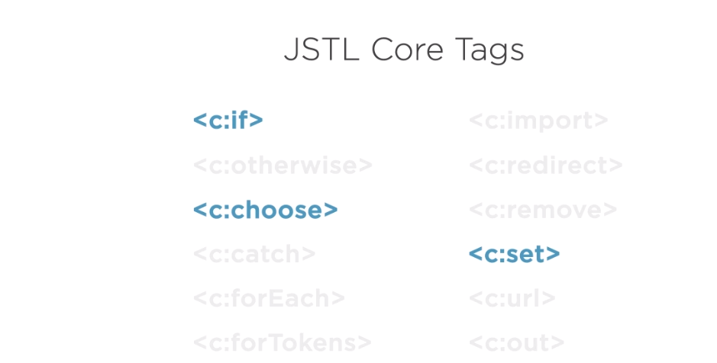

Slide 26
JSTL Functions Library
Function | Function
contains() | substring()
containsIgnoreCase() | substringAfter()
endsWith() | substringBefore()
indexOf() | replace()
length() | trim()
startsWith() | split()
endsWith() | toUpperCase()
exception | toLowerCase()

Slide 27
JSTL Functions Library
Function | Function
contains() | substring()
containsIgnoreCase() | substringAfter()
endsWith() | substringBefore()
indexOf() | replace()
length() | trim()
startsWith() | split()
endsWith() | toUpperCase()
exception | toLowerCase()

Slide 28
JSP Standard Tag Libraries
JSTL Core
Control and Flow
JSTL Formatting
Date/Number Formatting Internationalization
JSTL Functions
EL Utility Functions
JSTL XML
Parsing XML
JSTL SQL
Executing SQL

Slide 29
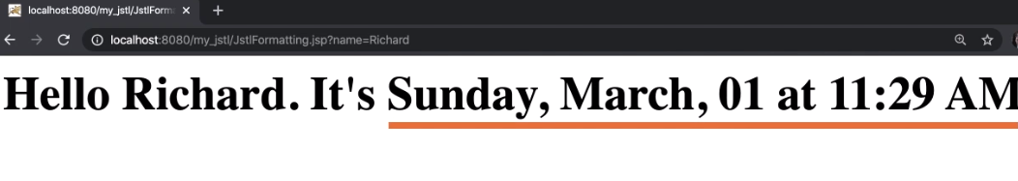

Slide 30
JSTL Function Tags
<fmt:formatDate>
<fmt:formatNumber>
<fmt:timeZone>
<fmt:parseDate>
<fmt:parseNumber>
<fmt:setTimeZone>
<fmt:requestEncoding>
<fmt:bundle>
<fmt:setBundle>
<fmt:setLocale>
<fmt:param>
<fmt:message>

Slide 31
JSP dynamic templating engine
Implicit JSP objects
JSP Expressions
Implicit Expression Objects
JSP Scriplets
JSP Declarations
Java beans
Java Standard Tag Library (JSTL)
Core
Functions
Formatting
Summary

